Slide 1

CO project
Presentation
G35

Slide 2


outline
Read and write
Read and write separately (RAWAN)
Read
Read when master was busy (NOURAN)
READ
READ the data that master write (MAHINOUR)
WRITE
WRITE THEN READ when target was busy (RENAD)

Slide 3
Block diagram
HERE ,WE HAVE 3 MODULEs (TARGET DEVICE , MASTER (TEST BENCH),CLOCK)
MASTER
DEVICE
AD
CONTROL SIGNAL
UNIT
LARGE
BUFFER
SMALL BUFFER
clk

Slide 4
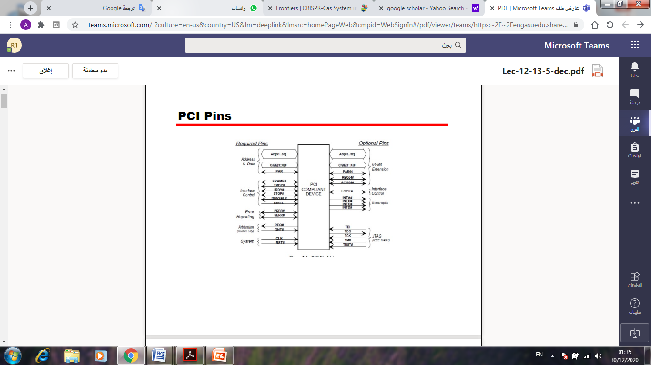
PCI pins:
Command [3 : 0] :
* Memory Read (0110).
* Memory Write (0111).
For Target Device :
AD input/output 32bit.
C/BE input 4bit.
Frame & IRDY inputs.
Clock & reset inputs.
DEVSEL & TRDY outputs.

Slide 5
ADDITIONAL SIGNAL
R | It’s the BE after extension
adr | Address location in the small buffer
ladr | Address location in the large buffer
ADREG | Temporary register when AD is output
ENABLE | Check whether AD signal is input or output

Slide 6
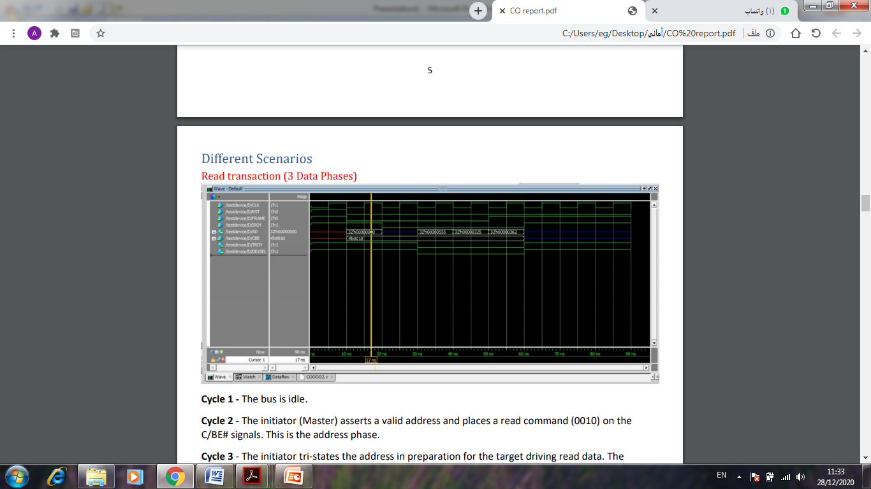
Memory Read:
Note :
* Address Phase then Data phase.
* In read operation Master sends address then receives data from Target on the same AD port.
*At the end of transaction all signal go in tri-state : AD & C/BE high impedance ,IRDY and TRDY and FRAME and DEVSEL high (1).

Slide 7
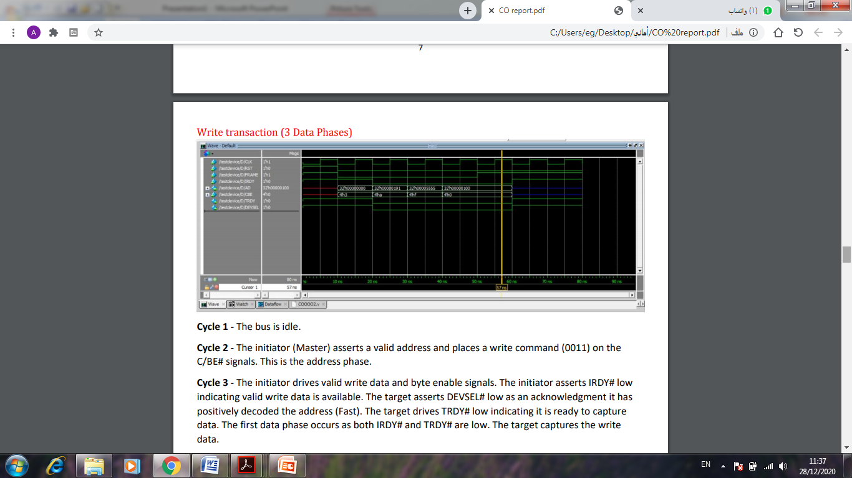
Memory Write :
Note:
*NO turn around cycle between Data and address phase because there is no devices change on the bus.
* In write operation both Address &Data send from Master device.

Slide 8
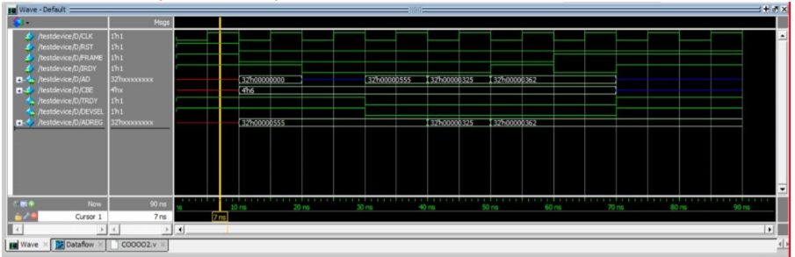
Read With IRDY =1 The initiator deasserts IRDY indicating it’s not ready to capture the data provided by the target and after one cycle IRDY = 0 and the third data is captured & initiator drives FRAME high indicating it’s the last data.

Slide 9
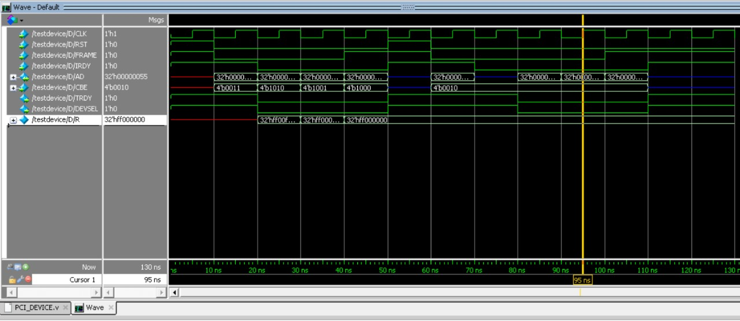
Read the data the master write
-A write transaction starts where the master starts writing 3 data in the buffer in the target.
-Then Turn Around cycle happens.
-The read transaction then begins and the master reads the same data from the buffer.

Slide 10
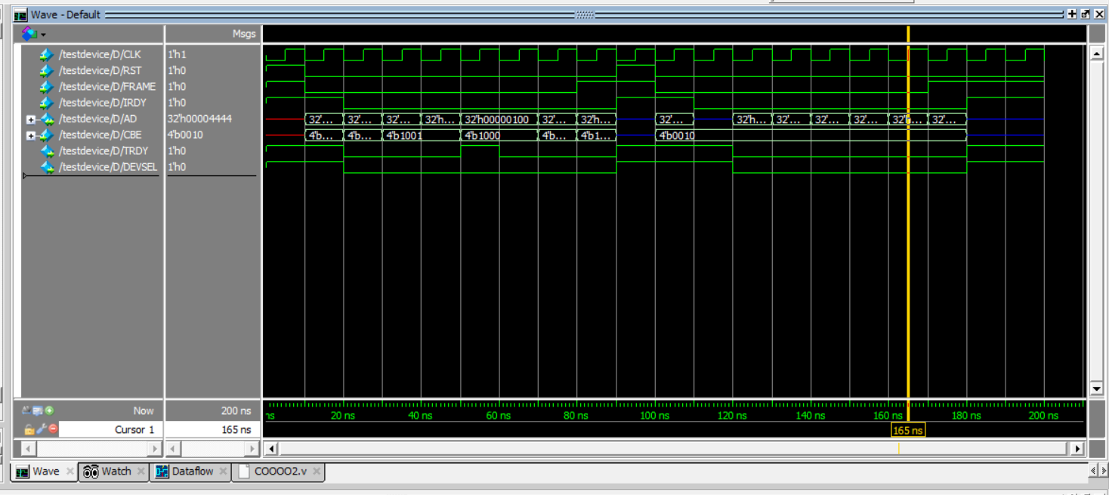
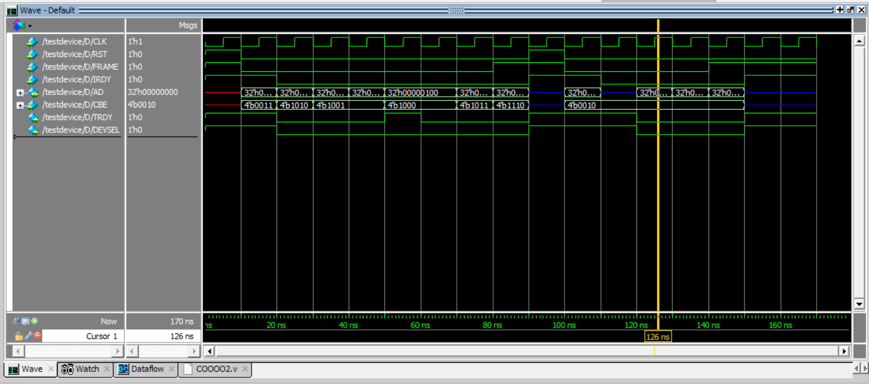
Read and write while Target was busy
In this case we want to WRITE data that is More than the buffer size so we will move the data to another one bigger ;
Meanwhile the target device will be busy so the TRDY signal will be =1;
Then will back to ZERO to WRITE the data then READ from it .
HINT : buffer size =3.
Write and read 6 data although our buffer =3
Write 6 data and read 3

Slide 11


Thank you

